Slide 1












MagTrack+
ASSET TRACKING
Asset tracking plus for motorized and non-motorized assets.
Tracking simplified.

Slide 2






MagTrack+
STICK IT
Put MagTrack+ where you need it on any magnetic surface.
Asset tracking simplified.
Stick. Monitor. Recover.
The low maintenance, balanced solution for moving and non-moving assets that need occasional monitoring.
MONITOR IT
Easily view assets on mobile or desktop with reports and custom alerts.
HIGH VALUE
At a low cost to customers. Extend the value you’re providing customers by ensuring valued assets are safe and easily recovered with dual band tracking.
RECOVER IT
Crank up motion updates when a suspicious activity has occurred

Slide 3














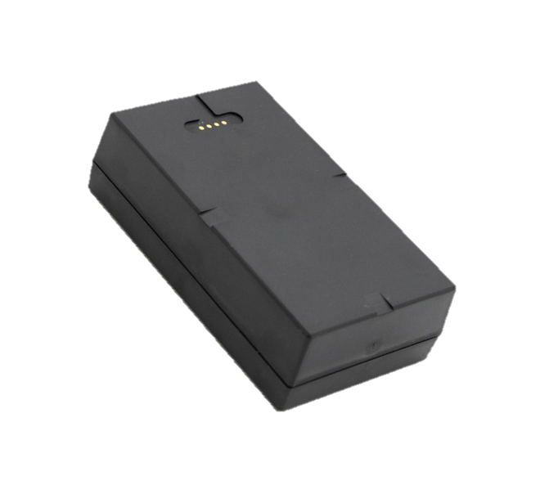
MagTrack+
GEOFENCES
& CUSTOM ALERTS
Custom geofencing to identify asset movement
A magnetic device meant to be quickly attached to any asset for tracking and theft recovery.
LOW BATTERY ALERTS
Eliminate risk of losing an asset
5
5 YEAR LIFE
Daily pings extend battery life, increase as needed
YEARS
GPS MOVEMENT
Location & speed configurable reporting intervals (moving or stationary)
STORE & FORWARD
Store up to 1,000 messages if signal is lost
NOTIFICATIONS
Custom alerts to detect unwanted movement & actions
ELEMENT PROOF
IP65 waterproof / -4°F – 140°F

Slide 4

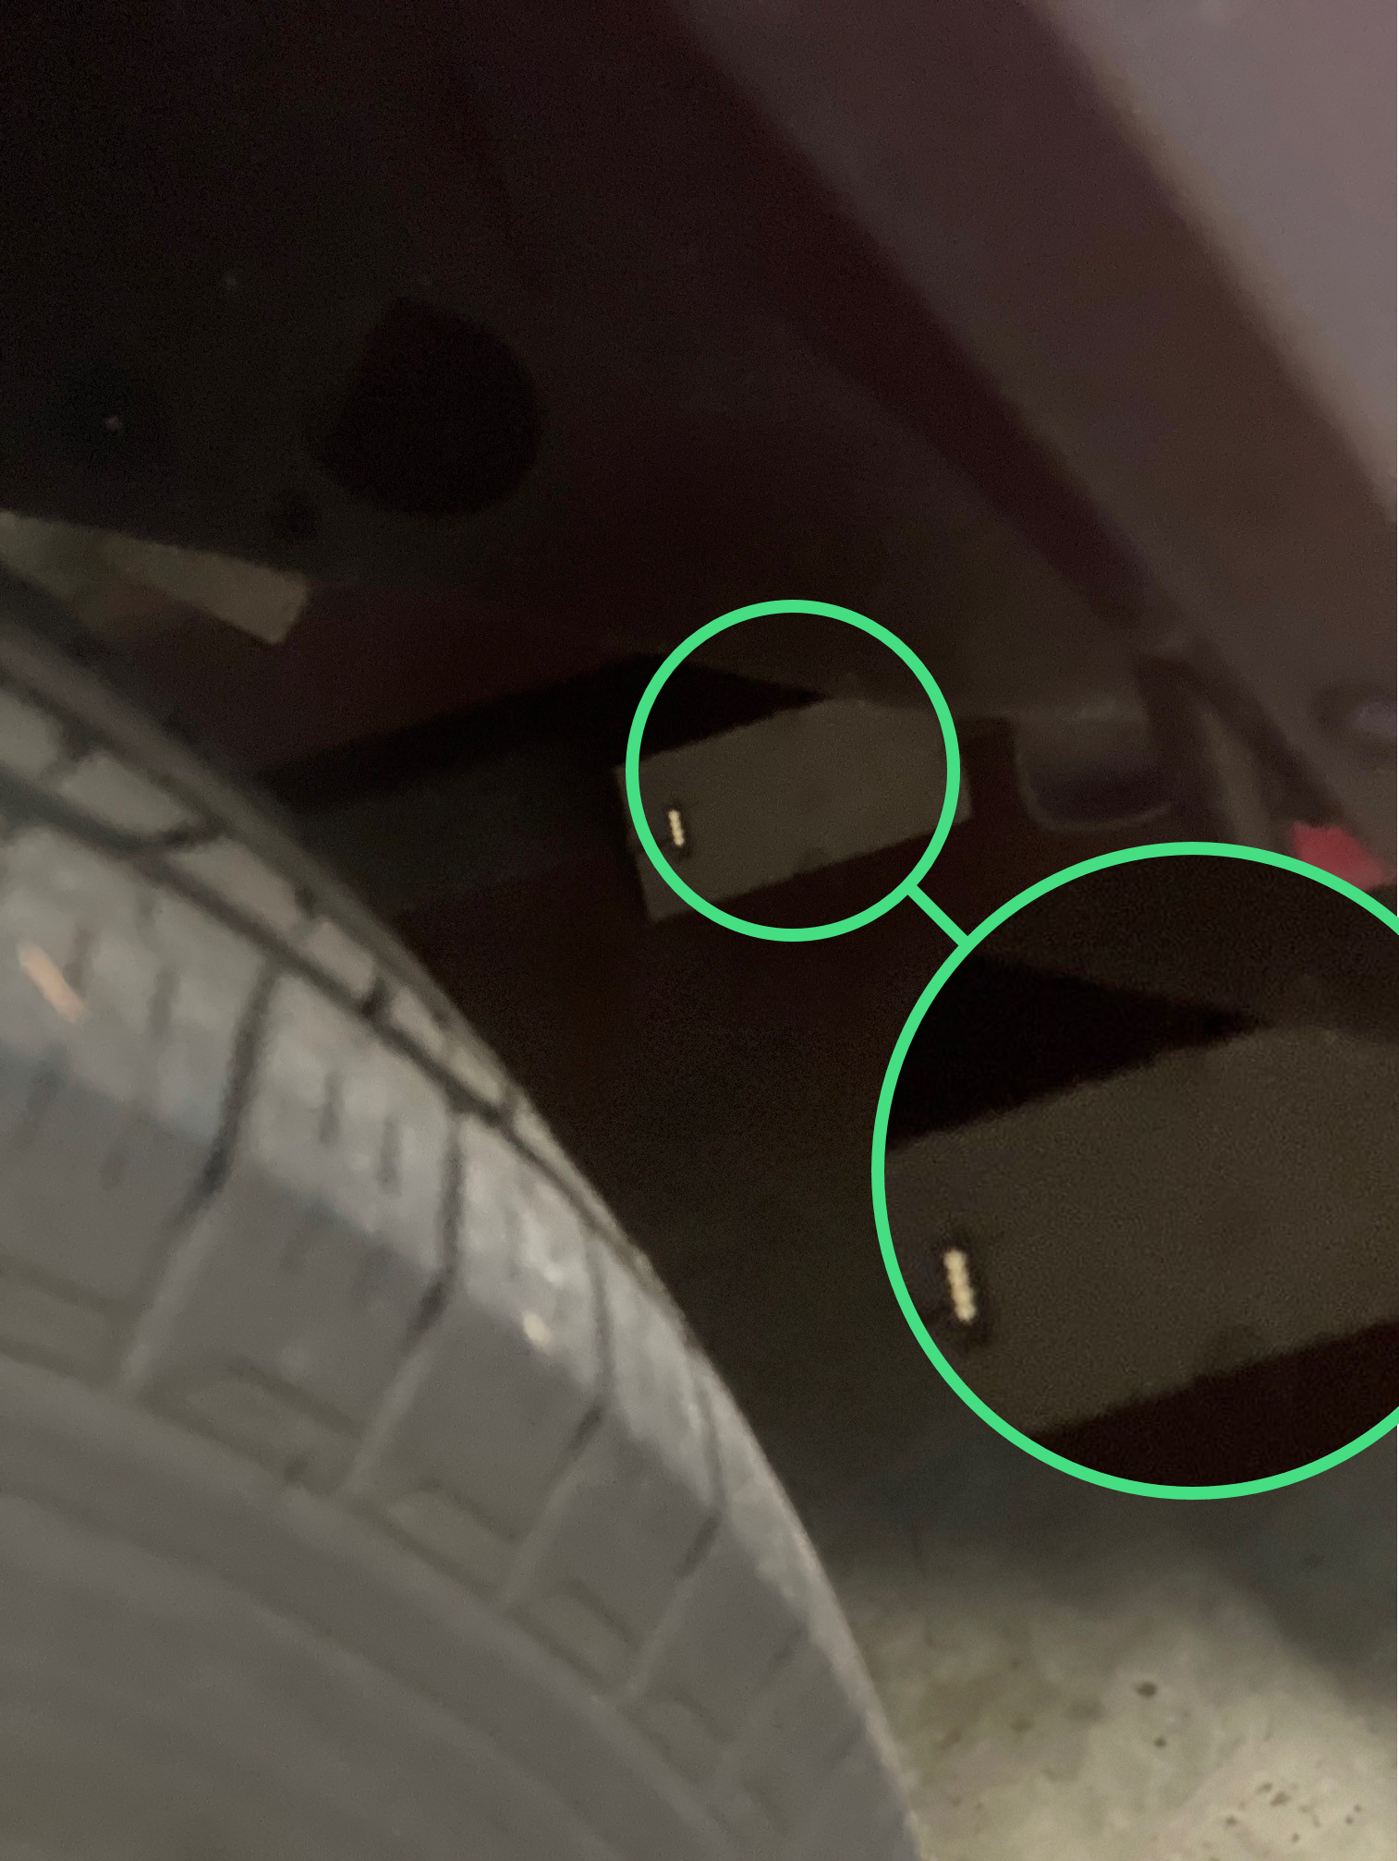




MAGNETIC
BUILT TO STICK
Quickly attach of move 4g device from asset to asset
MAKING IT EASY TO STICK IT TO THEM.
The only magnetic device that doesn’t need reinforcement. Sticks tight to any magnetic surface.

Slide 5

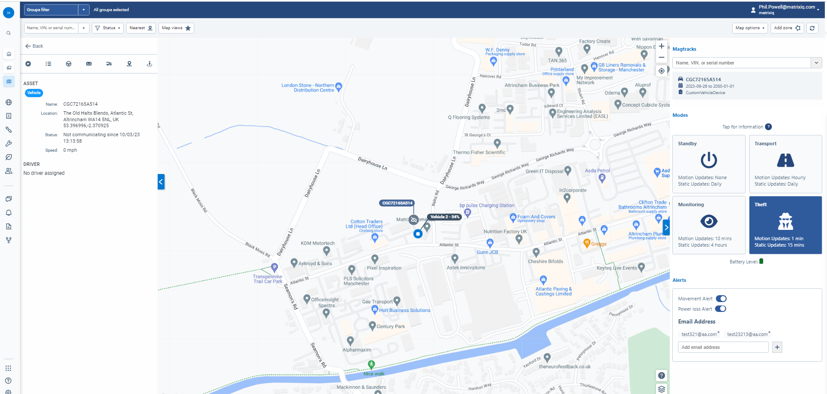
SINGLE SCREEN INTERFACE

Slide 6




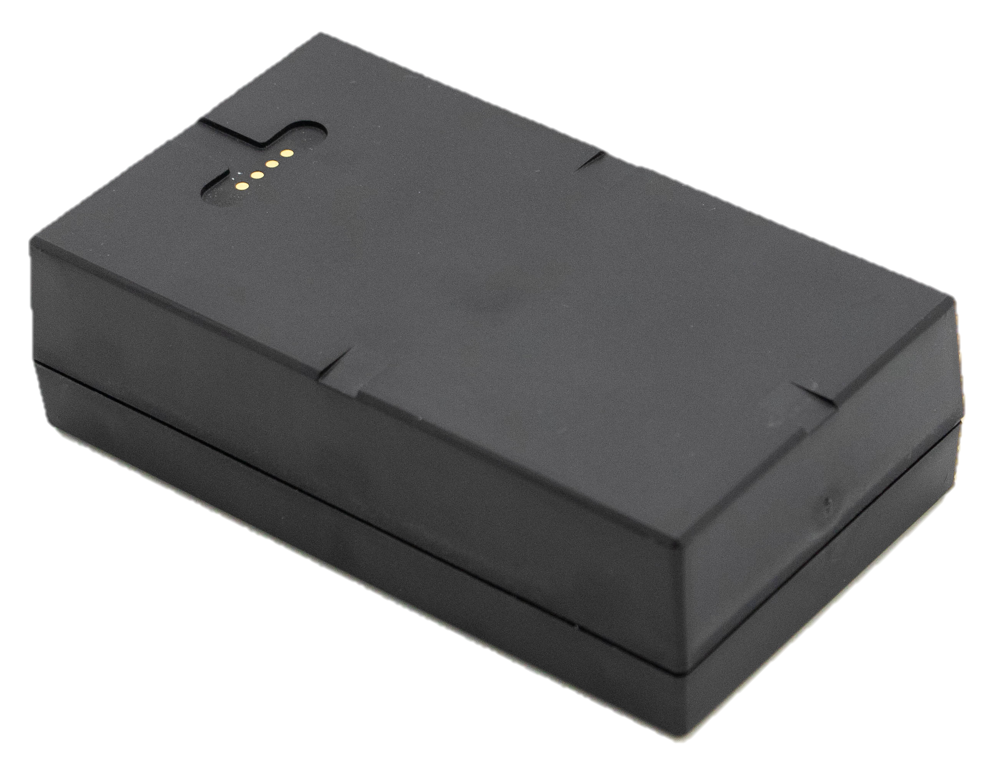
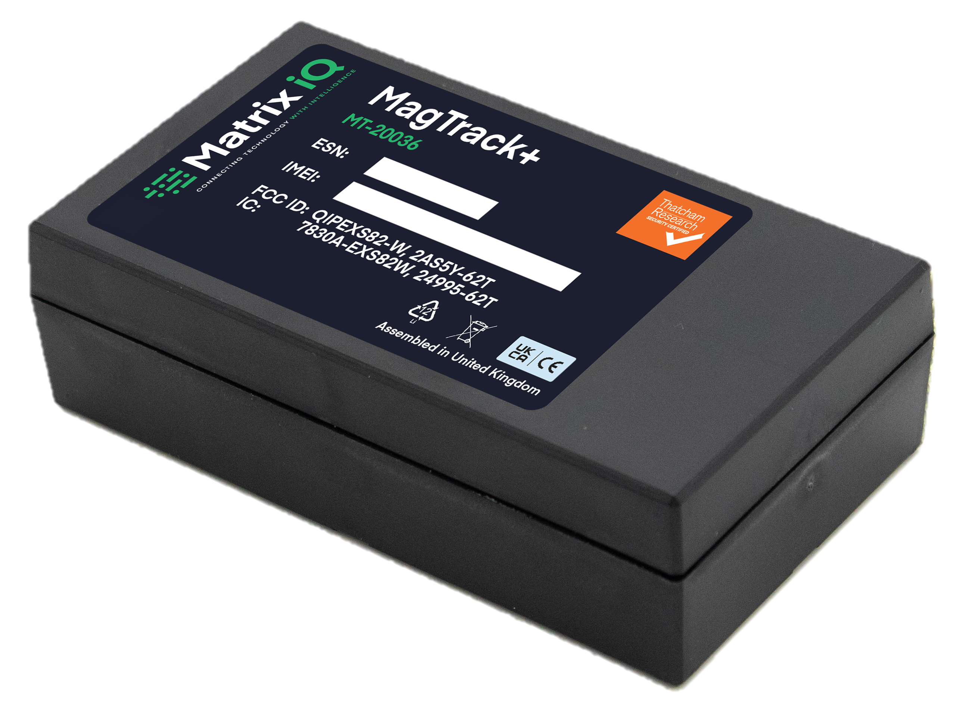
MagTrack+ TECHNICAL SPECIFICATIONS
Case Materials: PC-ABS
Dimensions: 107mm x 61mm x 32mm
Weight: 343g
Operating temp & ingress protection: -20°C/-4°F to +60°C/140°F / IP65
Approvals: FCC, IC, CE (RED)
Electrical Protection: IEC 61000-4-2 Level 4, ESD rating class 3B and class C undervoltage, overvoltage and overcurrent protection
Power source: Lithium-ion rechargeable batter pack 6AHr 3.7V
Charging current: <450mA at 5V
Frequency bands: GSM 850/900/1800/*1900, LTE Cat M1 700/8500/850/900/1800/1900/2100, LoRa 868MHz
Location: GPS/Glonass/BeiDou/Galileo
Notes:
Low failure rate
.5%
1000 devices in the field

Slide 7


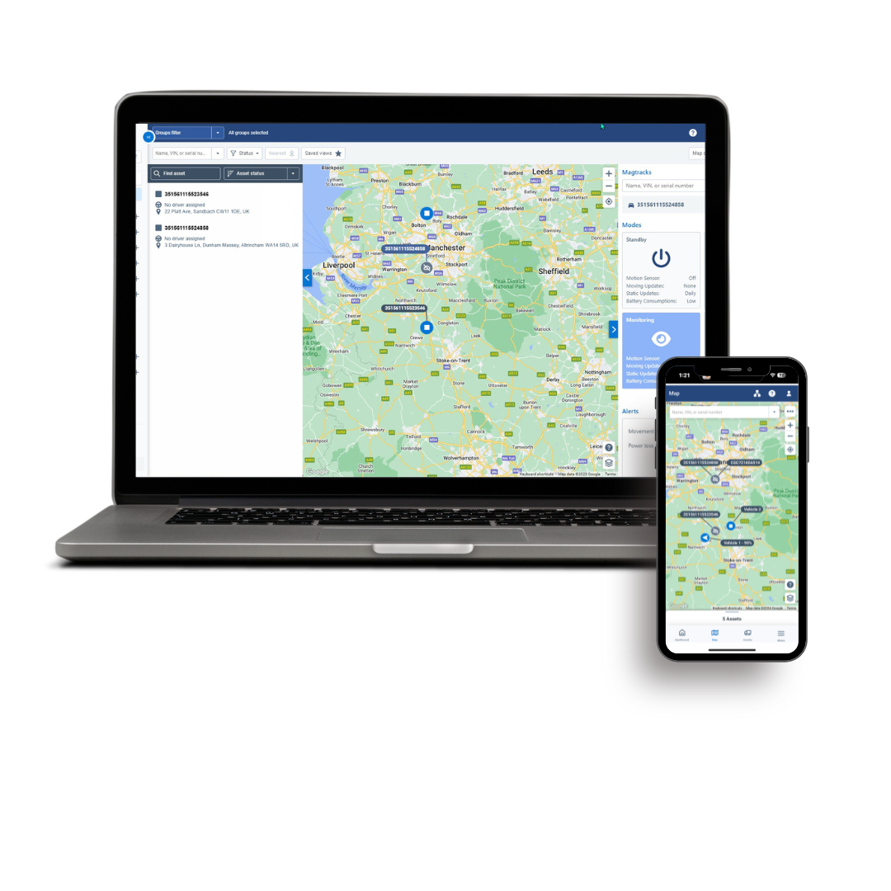
MagTrack+ FEATURES
Send GPS (location & speed) information to your application server with configurable report interval (moving or stationary)
Circle and polygon geofencing
Stores up to 1000 messages when signal is lost
Can wake when movement is detected and power down when stationary
When battery is low, the device sends ‘low battery’ alarm message
Device reports cell-ID based location information where GPS is not positioned
Configuration, setting and firmware can be remotely upgraded
IP65 waterproof

Slide 8

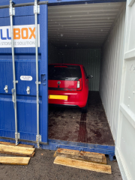
West Pennine Insurance Group
RESULTS
CASE STUDY
The Challenge
In order to increase customer satisfaction and retention rates, West Pennine Insurance Group came to us looking for a device they could offer their policyholders to help them protect their high value vehicles.
The solution needed to be:
Easy to install to avoid delays in setup and expensive installation costs
Discreet and difficult to locate to reduce the risk of the device being removed
Thatcham S7 certified to open the door to potential policy discounts
Linked to a Stolen Asset Recovery Network (S.A.R.N) to help their customers recover their vehicles
The Trial
Our magnetic MagTrack+ device was designed for exactly the above purpose but, before recommending it to their policyholders, West Pennine Insurance Group wanted to see it in action so we agreed to run a trial.
The setup:
Early in the morning, one of their vehicles was hidden inside a shipping container in an unknown location with one of our MagTrack+ devices attached
At 10:27am, Theft Mode was activated and the details of the vehicle were verified so a team could be deployed to secure the vehicle
minutes after stolen report an asset recovery team on the road.
minutes after the initial report, the team arrived on site at the location of the vehicle
minutes after initial report, vehicle located in a shipping container
<25
IMAGE
PLACEHOLDER
57
73

Slide 9

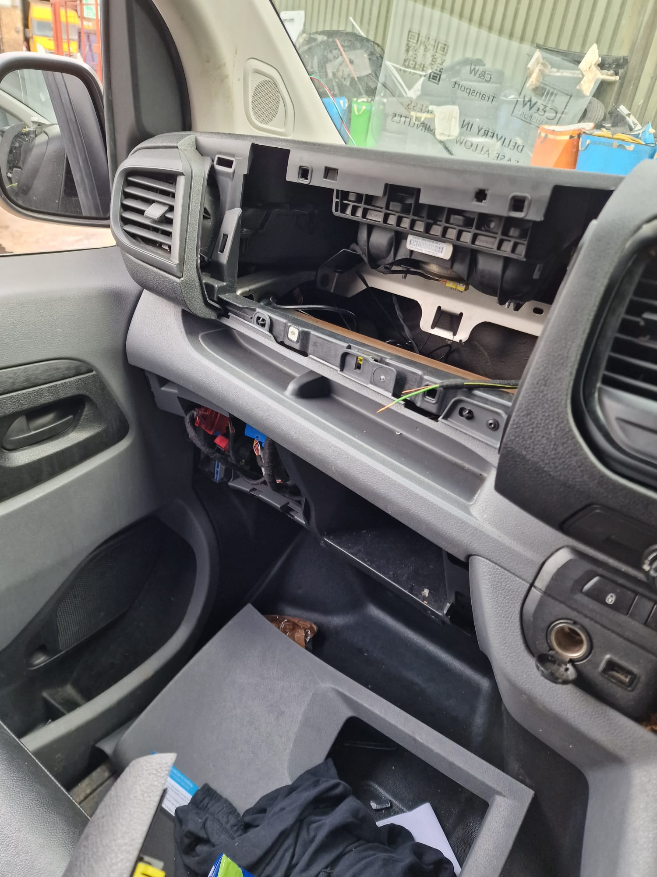
C&W Transport
recovery
CASE STUDY
The Theft
21st September 6:15pm
C&W’s new £30,000 Vauxhall Vivaro is stolen while in Putney, SW London.
The van’s hardwired incident camera & tracking system is ripped out by the thieves to stop C&W from tracking the vehicle (see picture).
Unknown to the thieves, the vehicle is also fitted with one of Matrix iQ’s covert MagTrack+ devices (battery powered, magnetic stolen asset tracking unit).
C&W contact Matrix to report the vehicle as stolen. Matrix place the MagTrack+ unit into “Theft Mode” which increases the unit’s location updates to every 60 seconds while the van is in motion / every 15 minutes while stationary.
PRECISION location shortly after mode change to a row of garages
MOVEMENT alert showing that vehicle is on the move stopping at a local body shop
INTERCEPTED quickly and recovered with camera and tracking system removed and false license plates affixed
IMAGE
PLACEHOLDER

Slide 10
Matrix iQ
ESTABLISHED IN 2001
Highly evolved hardware agnostic cloud-based SaaS platform
70,000+
Fleet vehicles tracked every day on our fleet portal
DRIVER SCORE ALGORITHMS
Refined algorithms independently verified against claims data
IN HOUSE DEV TEAMS
Specialist telematics platform and app developers
SAFETY & RISK FOCUS
Focus on use of telematics and data to derive safety, compliance and ROI
ACCESSIBLE DATA
All data available on secure API access for integration with 3rd party software applications

Slide 11
RESELLER CONNECTION
CYNDI BRANDT
EVP Partnerships & Channel
cyndi.brandt@matrixiq.com
410.215.2295
This document contains proprietary information from Matrix iQ and is not disclosed or used except in accordance with applicable agreements.
Pricing effective January 2024 and subject to change.

